Slide 1
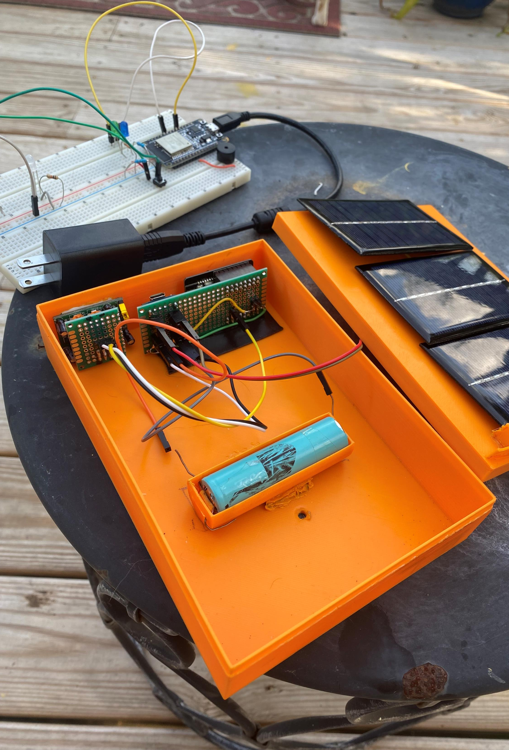
T-Detector
Aaron Bading

Slide 2
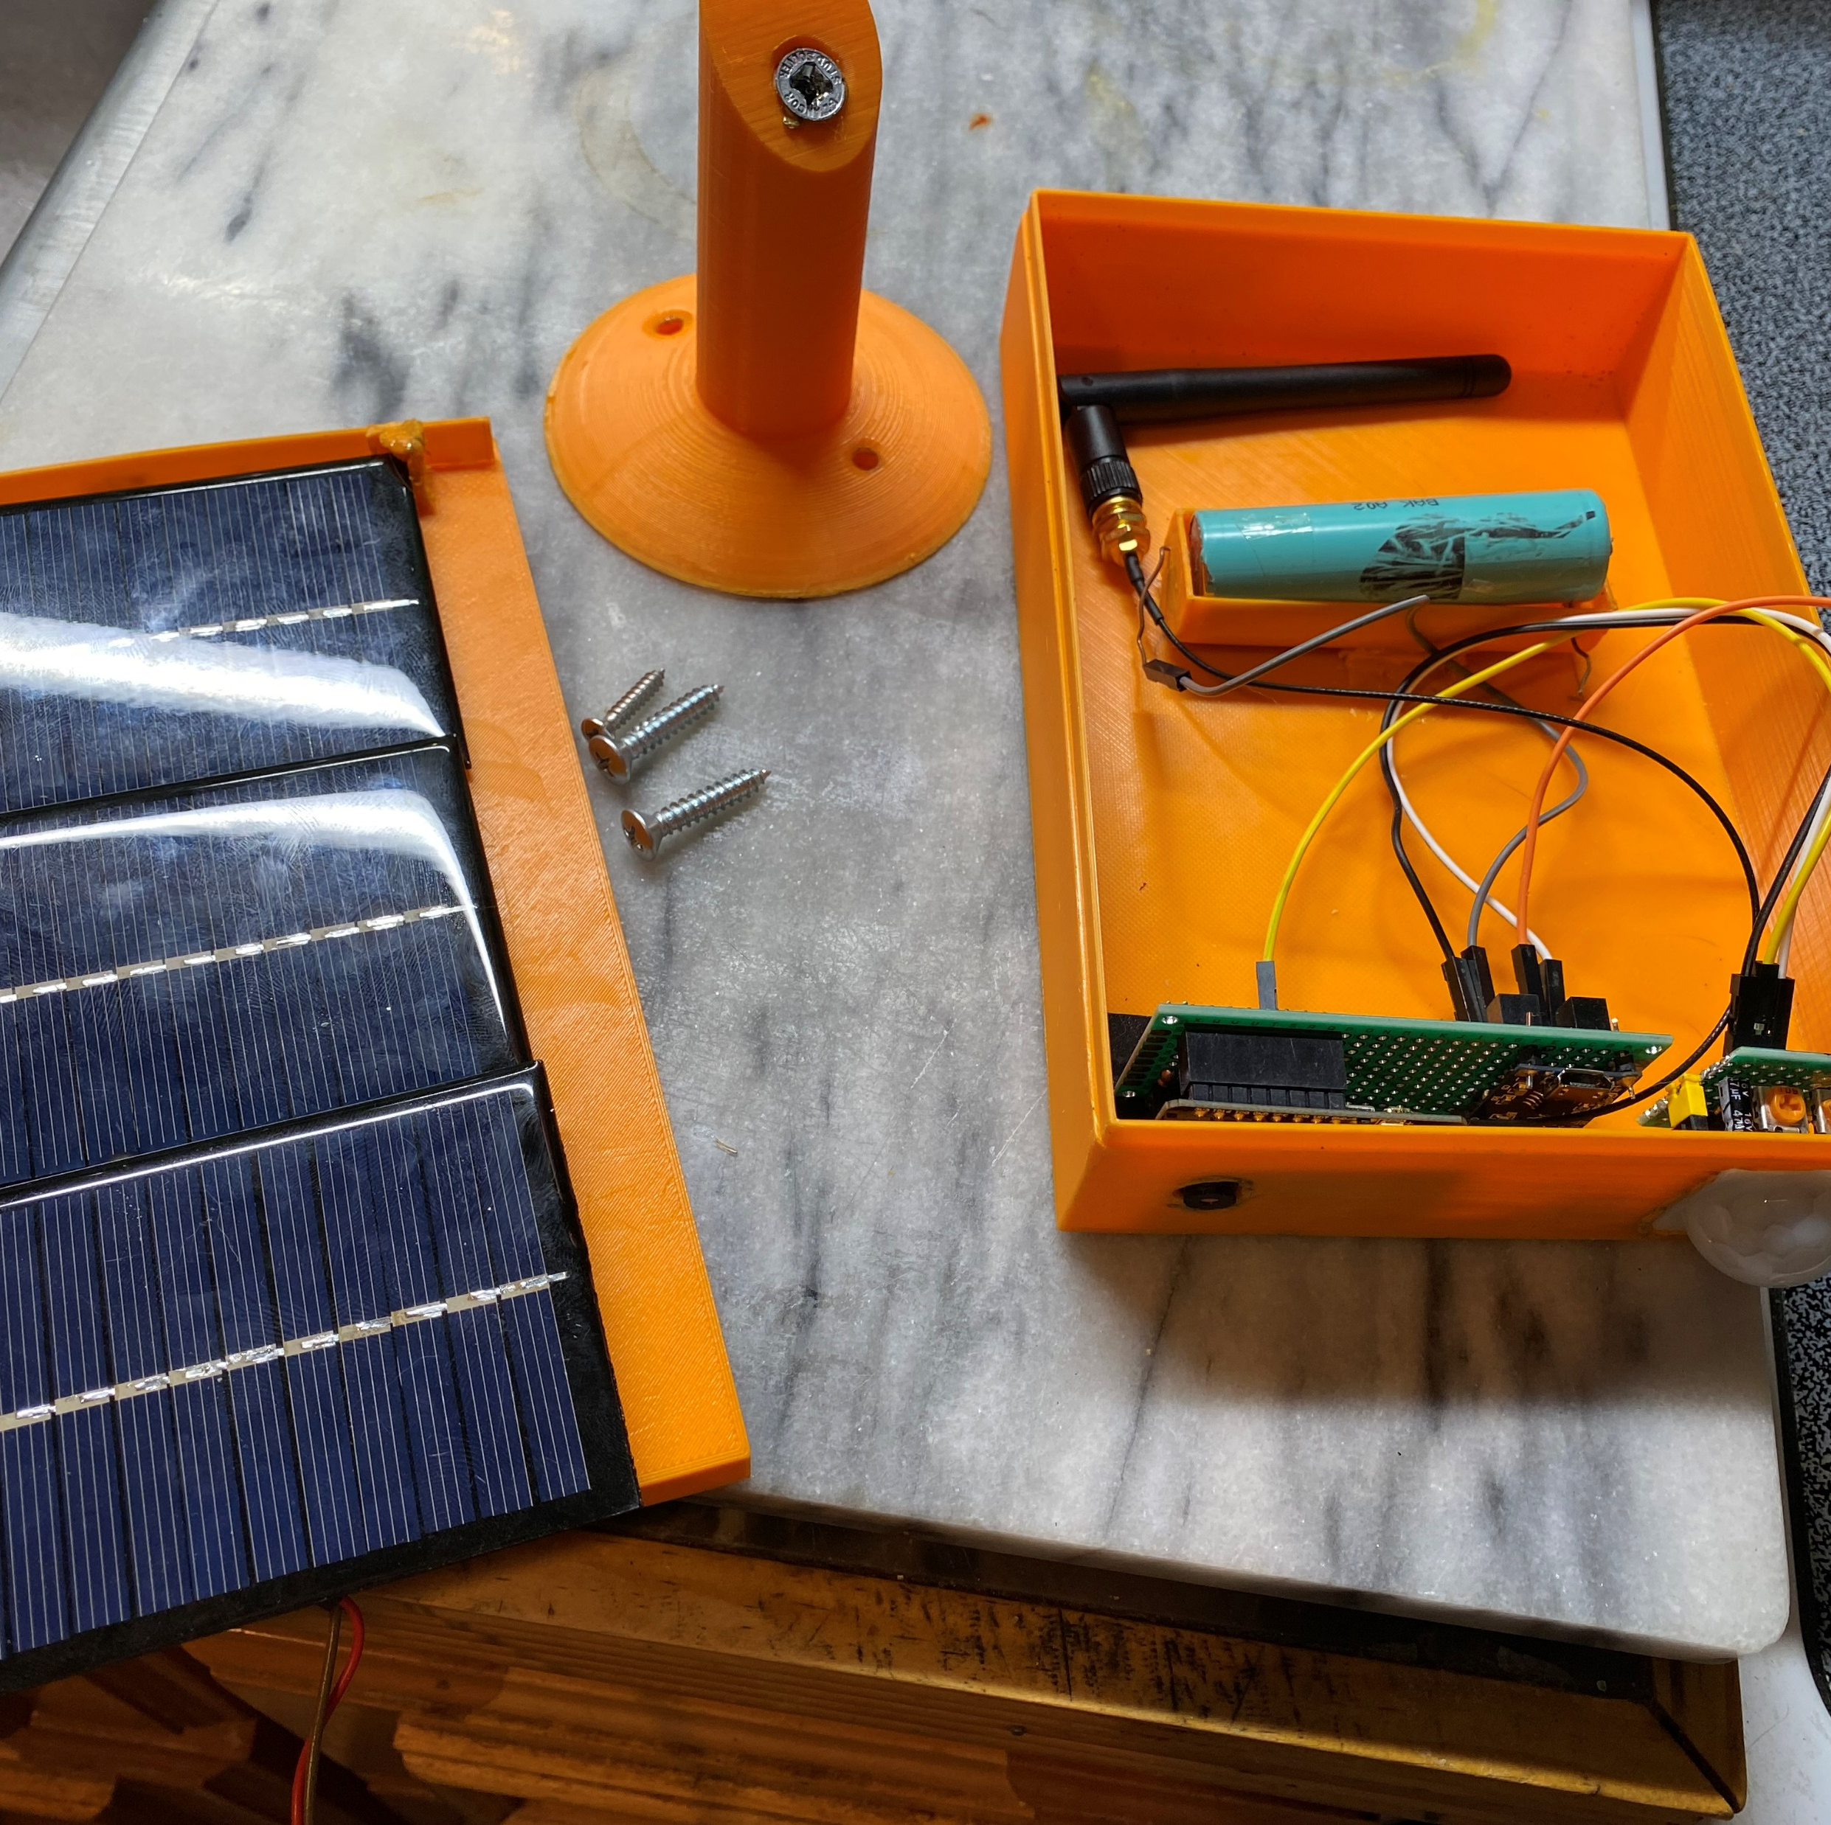
General Description
This projects acts as a motion sensor controlled front door camera that is accessible from any phone or computer.
When motion is detected, an inside ESP32 unit will make a buzzer go off to notify you that someone has arrived.
Communication between ESP-Cam and ESP32 is done via ESP-NOW ; a wireless communication protocol developed by ESPRESSIF.
The project is powered by a lithium battery that is solar charged.

Slide 3
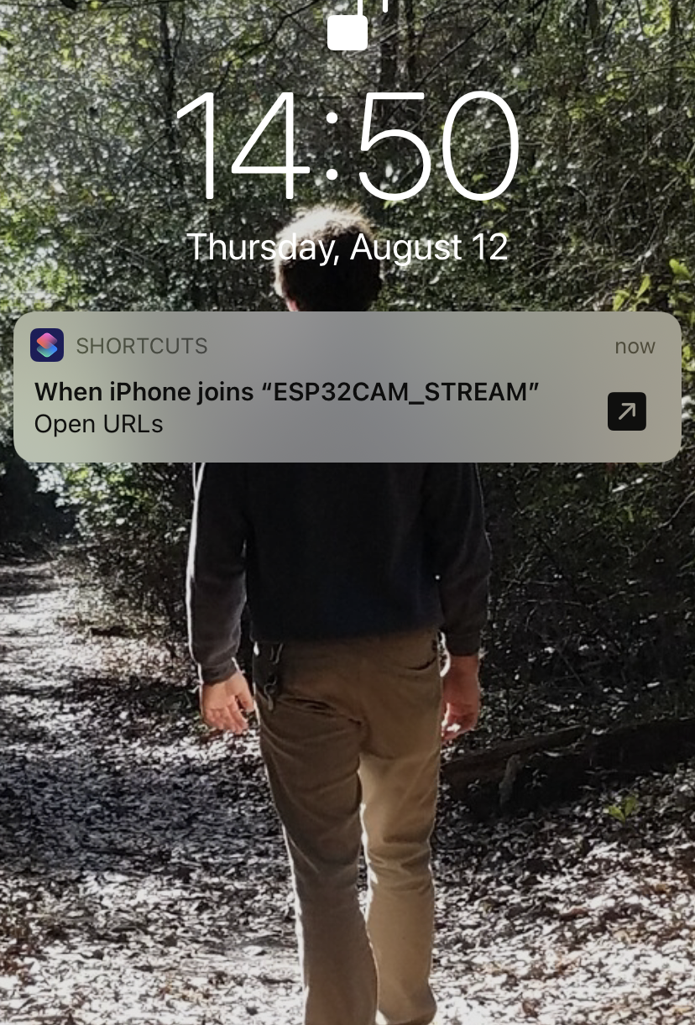
Functionality
This project is convenient because I can view who is at my door without even having to get out of my seat.
When motion is detected ,my phone gives a notification that the ESP’s local network was joined, and it will ask me if I want to access the associated URL.
This URL will enable me to see the live video feed and also control the boards with the press of a button.

Slide 4
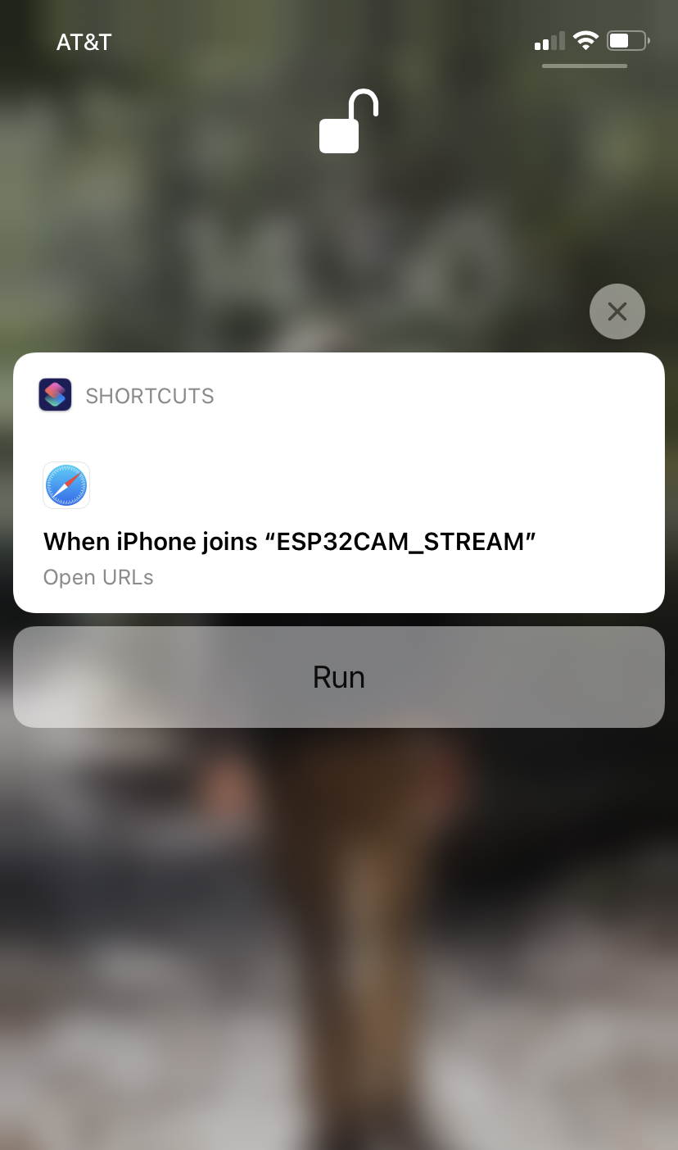
NOTIFICATION This is an example of what the notification looks like when motion is detected.

Slide 5
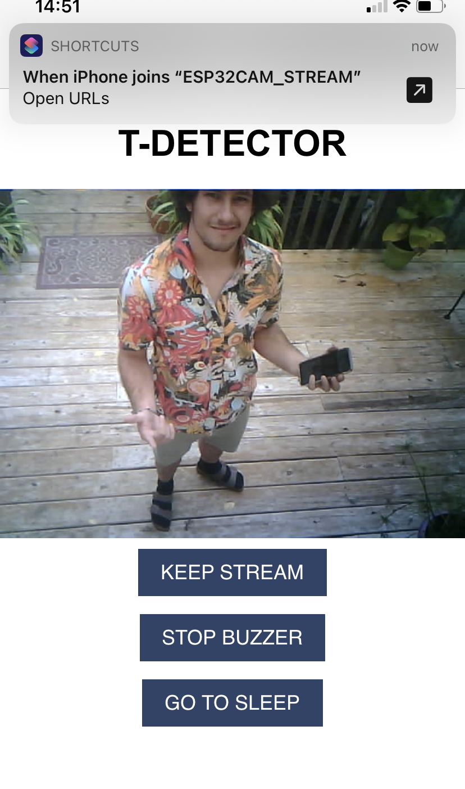
INTERFACE This is an example of what the Interface looks like.

Slide 6
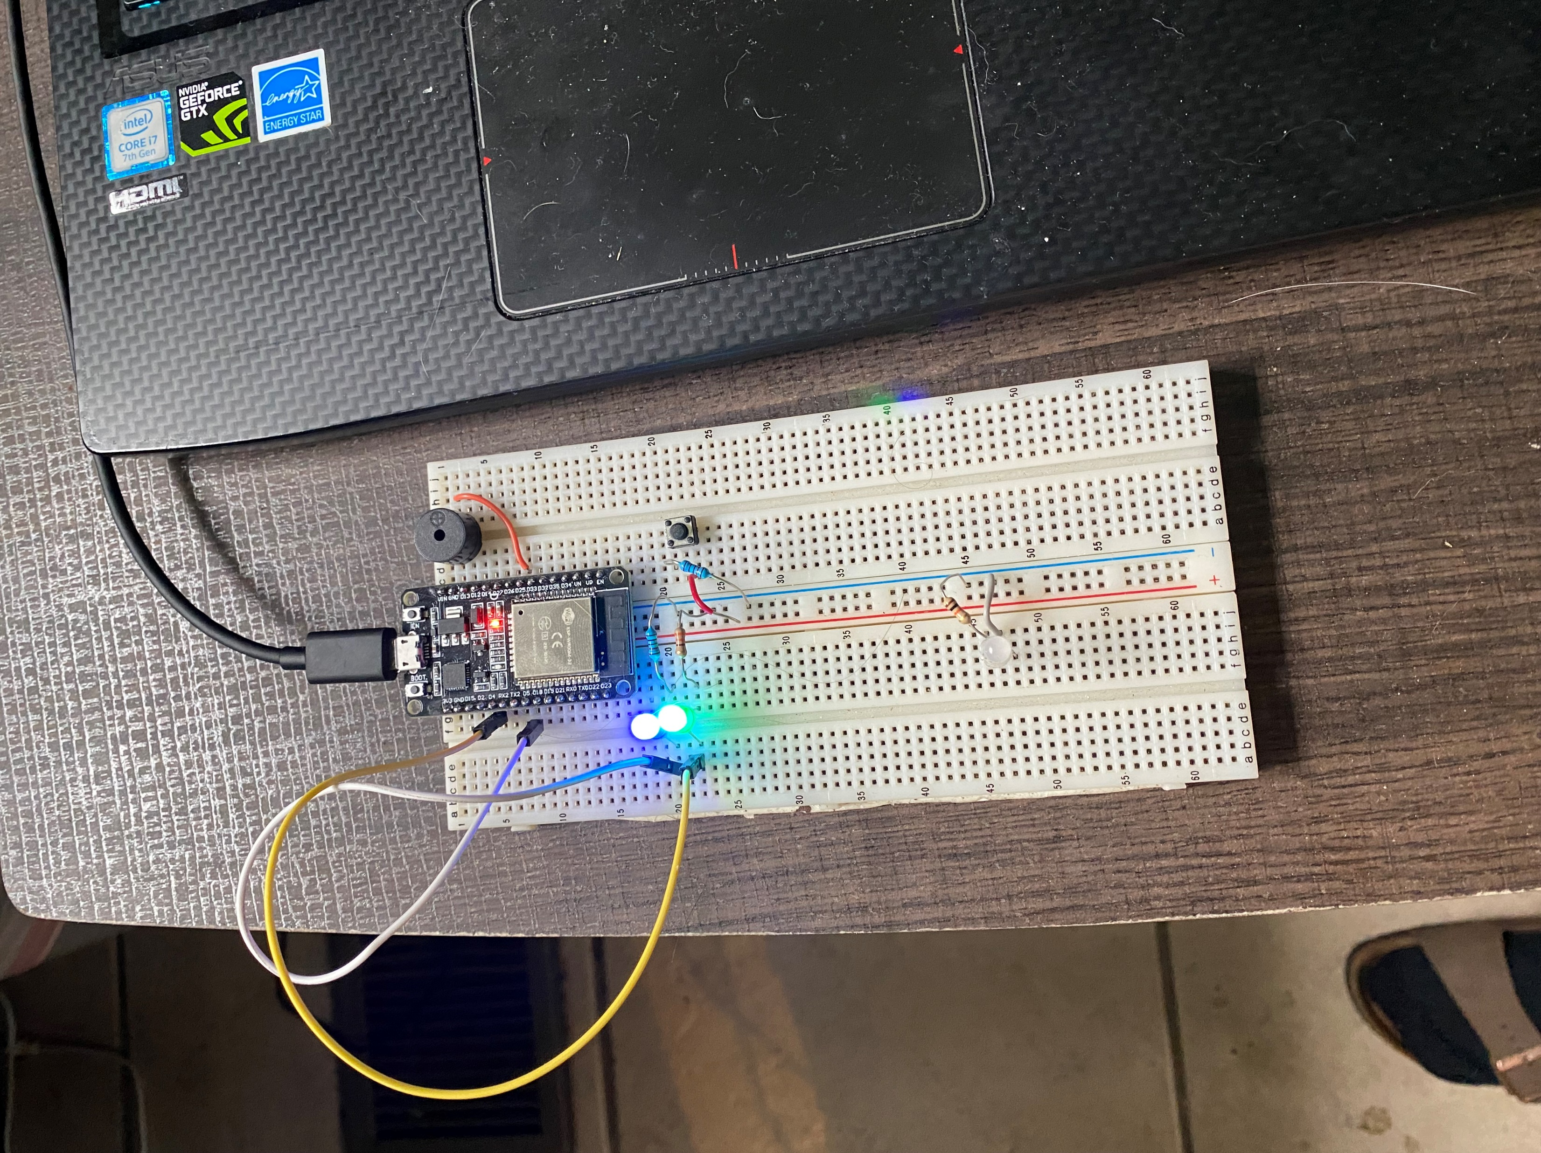
Inside Unit
This project includes a second ESP32 that is mounted inside that is connected to a buzzer.
This buzzer will play melodies when someone arrives at your front door .
This will notify you that you have to get up and see who is at your door.

Slide 7
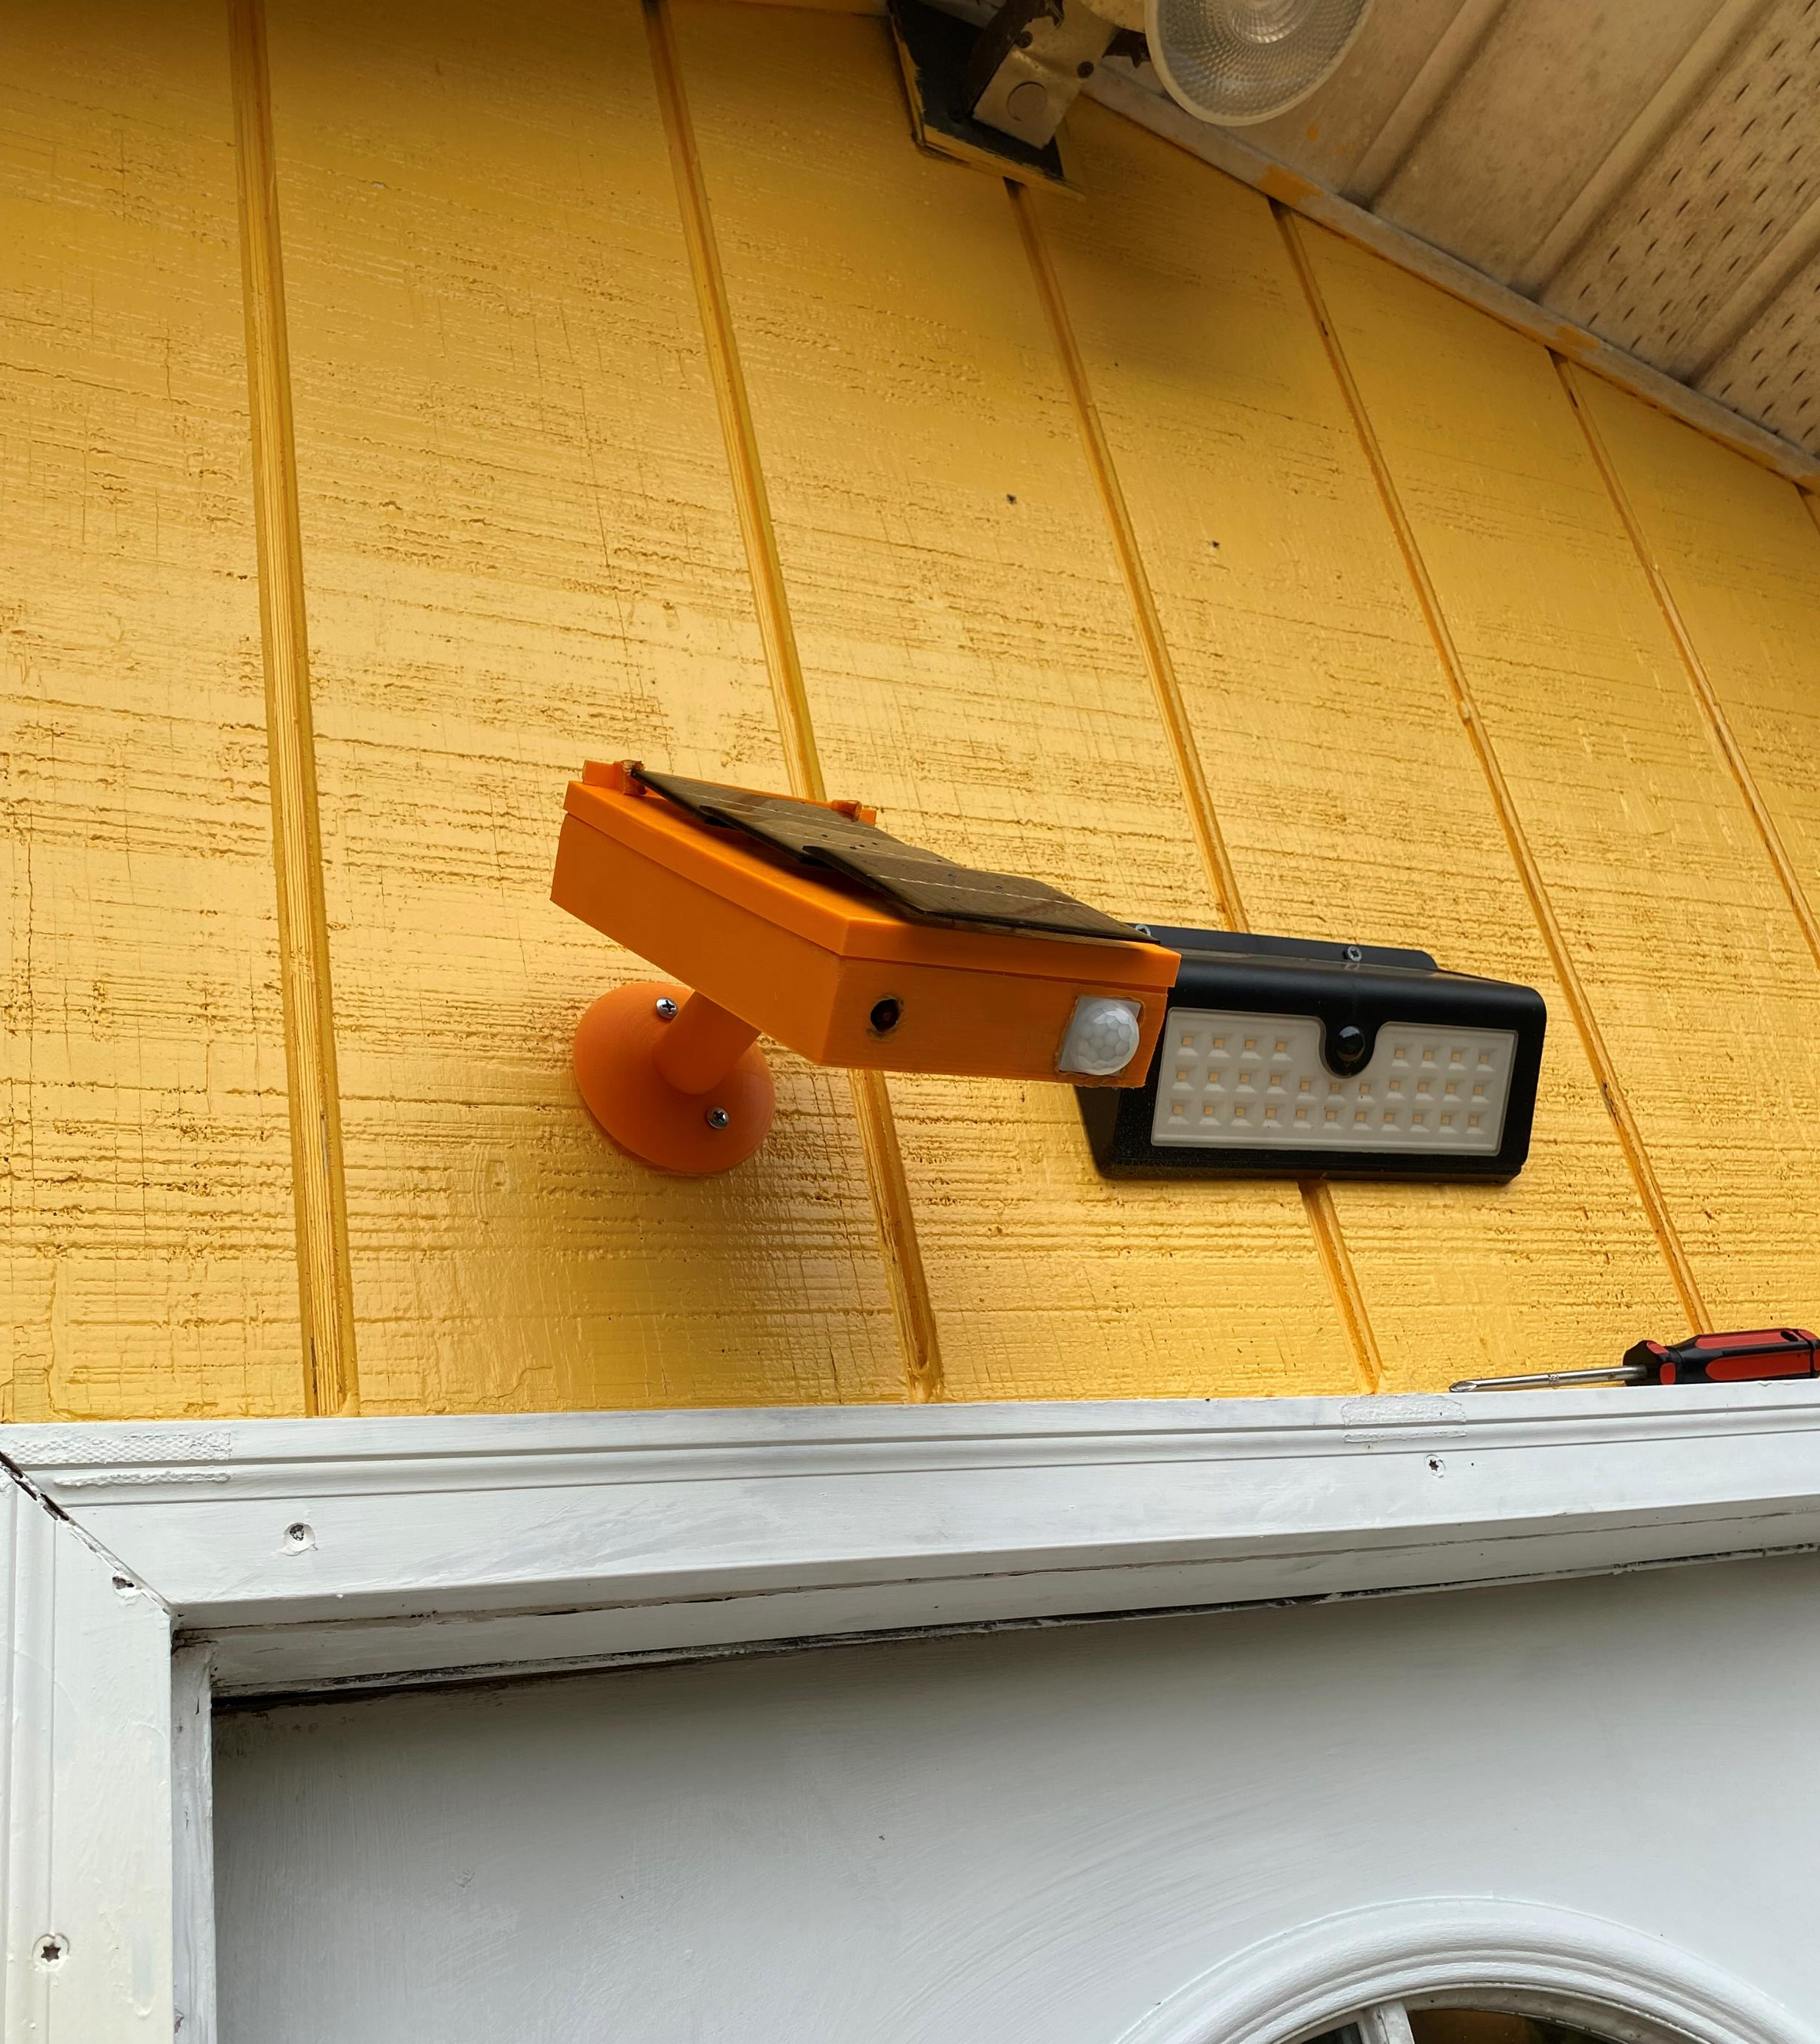
Finished Project

